Slide 1
LECTURE NOTES On Principles of Programming Course Code: COM122 COM 122 Principles of Programming
By Michael Kumakech

Slide 2
SYLLABUS - (12 Lectures)
Lecture 1: A Beginner’s Guide
Lecture 2: Introduction to Programming
Lecture 3: Introduction to C, structure of C programming
Lecture 4: Elements of C
Lecture 5: Variables, Statements, Expressions
Lecture 6: Input-Output in C
Lecture 7: Formatted Input-Output
Lecture 8: Operators
Lecture 9: Operators continued…
Lecture 10: Control Statements
Lecture 11: Iterative statements
Lecture 12: Jump statements

Slide 3
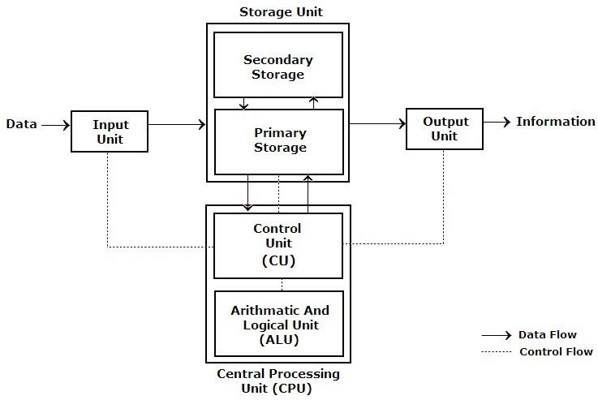
INTRODUCTION TO COMPUTERS
Any programming language is implemented on a computer.
Inputting: It is the process of entering data & instructions to the computer system.
Storing: The data & instructions are stored for either initial or additional processing, as & when required.
Processing: It requires performing arithmetic or logical operation on the saved data to convert it into useful information.
Outputting: It is the process of producing the output data to the end user.
Controlling: The above operations have to be directed in a particular sequence to be completed.

Slide 4
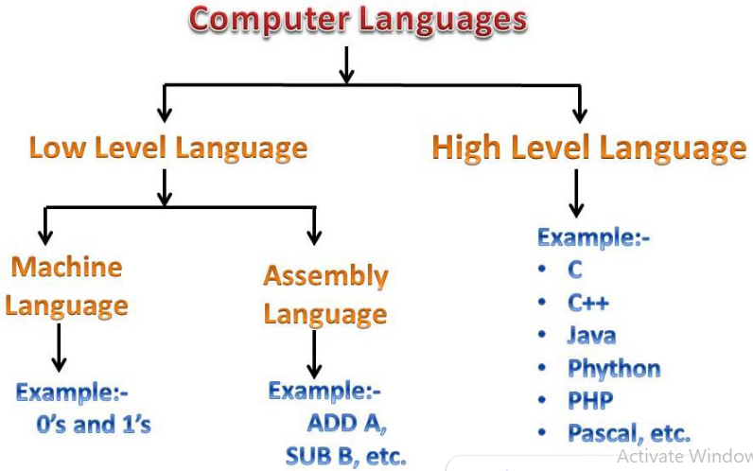
INTRODUCTION TO PROGRAMMING
A language that is acceptable to a computer system is called a computer language or programming language and the process of creating a sequence of instructions in such a language is called programming or coding.
A program is a set of instructions, written to perform a specific task by the computer. A set of large program is called software.
To develop software, one must have knowledge of a programming language

Slide 5
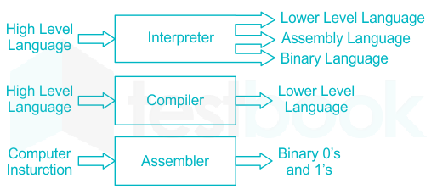
PROGRAMMING LANGUAGE TRANSLATORS
High-level languages allow programmers to write instructions in a language that is easier to understand than low-level languages.
Translators translate programs written in high-level languages into the machine code that a computer understands.

Slide 6
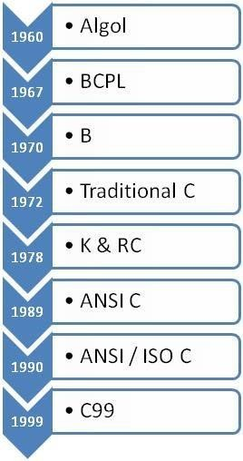
INTRODUCTION TO C
Brief History of C
The C programming language is a structure oriented programming language, developed at Bell Laboratories in 1972 by Dennis Ritchie.
C programming language features were derived from an earlier language called “B” (Basic Combined Programming Language – BCPL)
C language was invented for implementing UNIX operating system.
In 1978, Dennis Ritchie and Brian Kernighan published the first edition “The C Programming Language” and is commonly known as K&R C.
In 1983, the American National Standards Institute (ANSI) established a committee to provide a modern, comprehensive definition of C. The resulting definition, the ANSI standard, or “ANSI C”, was completed late 1988.
Many of C’s ideas & principles were derived from the earlier language B, thereby naming this new language “C”.

Slide 7
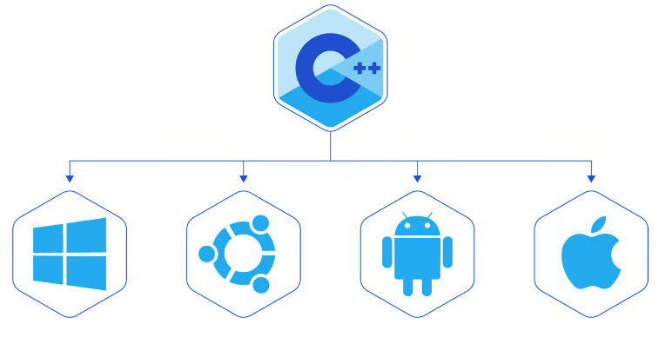
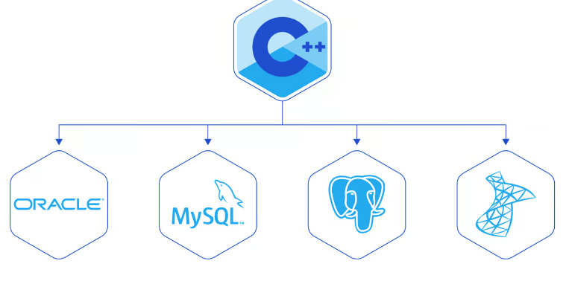
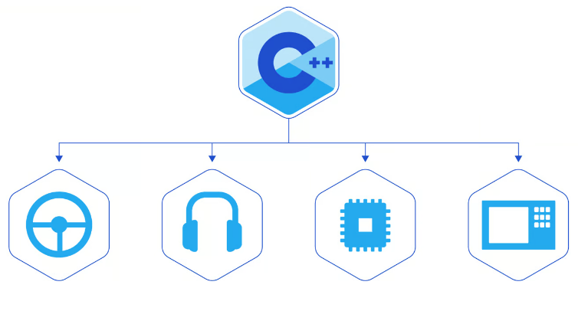
WHY IS C POPULAR
Despite the prevalence of higher-level languages, C continues to empower the world.
The following are some of the systems that are used by millions and are programmed in the C language.

Slide 8
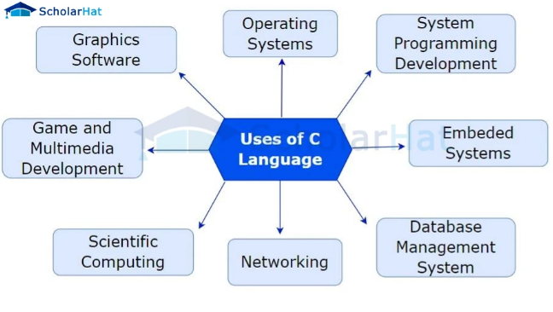
WHY TO STUDY C
By the early 1980s, C was already a dominant language in the minicomputer world of Unix systems. Since then, it has spread to personal computers (microcomputers) and to mainframes.
Many software houses use C as the preferred language for producing word processing programs, spreadsheets, compilers, and other products.
C is an extremely flexible language—particularly if it is to be used to write operating systems.
Unlike most other languages that have only four or five levels of precedence, C has 15.

Slide 9
CHARECTERESTICS OF A C PROGRAM
High Level | Middle Level | Low Level
High level languages provide almost everything that the programmer might need to do as already built into the language | Middle level languages don’t provide all the built-in functions found in high level languages, but provides all building blocks that we need to produce the result we want | Low level languages provides nothing other than access to the machines basic instruction set
Examples: Java, Python | C, C++ | Assembler

Slide 10
CHARECTERESTICS OF A C PROGRAM
Structure oriented | Object oriented | Non structure
In this type of language, large programs are divided into small programs called functions | In this type of language, programs are divided into objects | There is no specific structure for programming this language
Prime focus is on functions and procedures that operate on the data | Prime focus is in the data that is being operated and not on the functions or procedures | N/A
Data moves freely around the systems from one function to another | Data is hidden and cannot be accessed by external functions | N/A
Program structure follows “Top Down Approach” | Program structure follows “Bottom UP Approach” | N/A
Examples: C, Pascal, ALGOL and Modula-2 | C++, JAVA and C# (C sharp) | BASIC, COBOL, FORTRAN

Slide 11
Reading Assignment
https://www.scholarhat.com/tutorial/c/10-reasons-why-you-should-learn-c
https://www.toptal.com/c/after-all-these-years-the-world-is-still-powered-by-c-programming
https://www.bbc.co.uk/bitesize/guides/z4cck2p/revision/3
https://www.w3schools.com/c/c_intro.php

